Slide 1





Slide 2
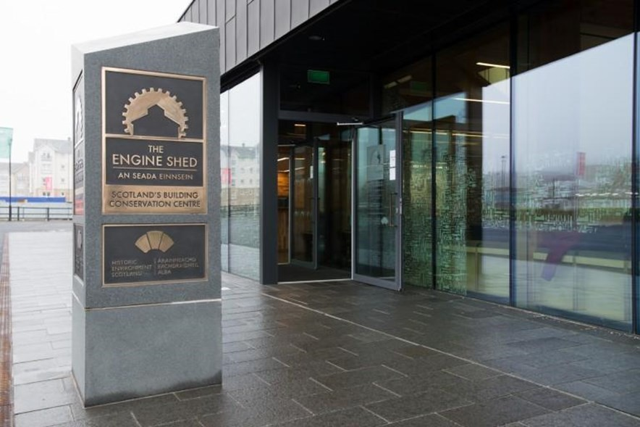
There is a sign on the front door which says The Engine Shed. The front door is automatic.

Slide 3

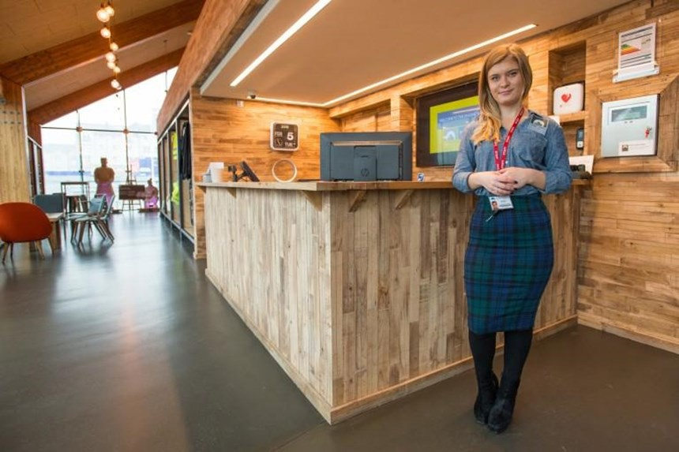
Above the door there is an air conditioning unit which can blow out hot and cold air and can be loud. At reception you will be welcomed by a member of staff. You will be asked for your postcode. You do not have to give this if you do not want to. You will be asked if you want to borrow a tablet. You do not have to borrow a tablet if you do not want to. If you need help you can go to reception at any time and speak to a member of staff.

Slide 4

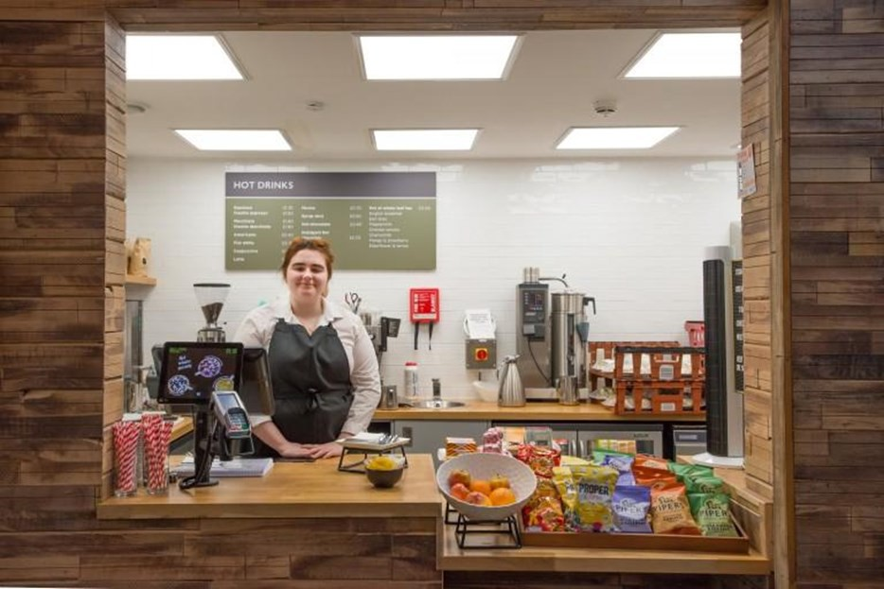
If you want to, you can buy food and drink at our Coffee Point. This space can be loud.

Slide 5

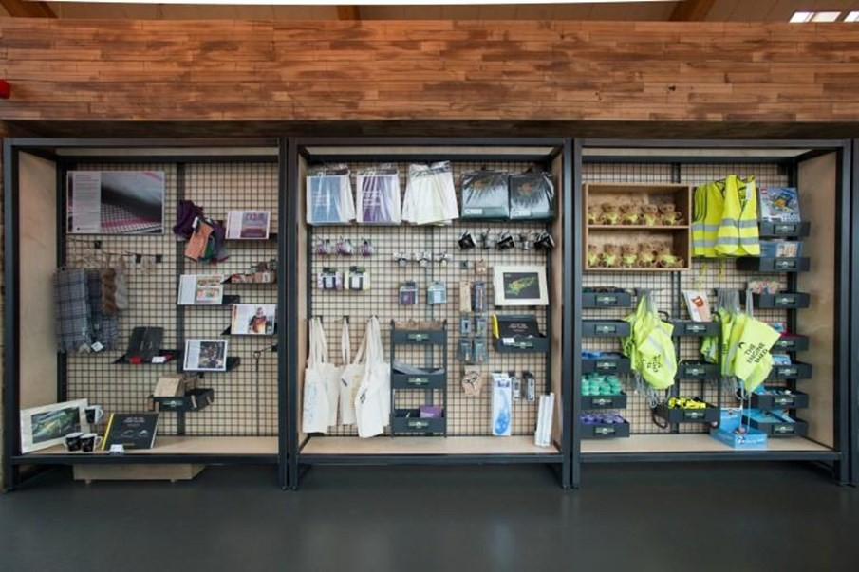
Th
If you want to, you can buy things from our shop.

Slide 6

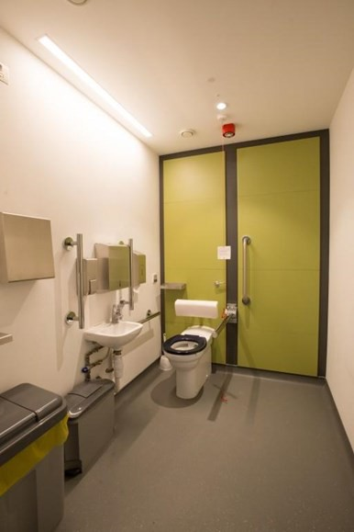
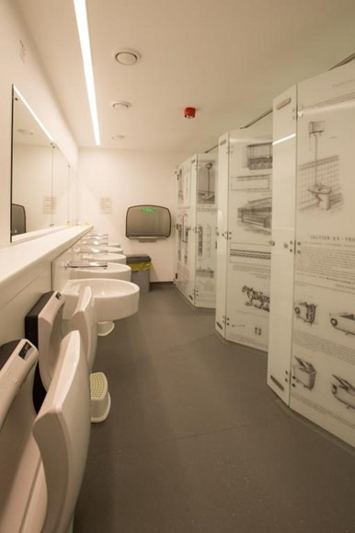
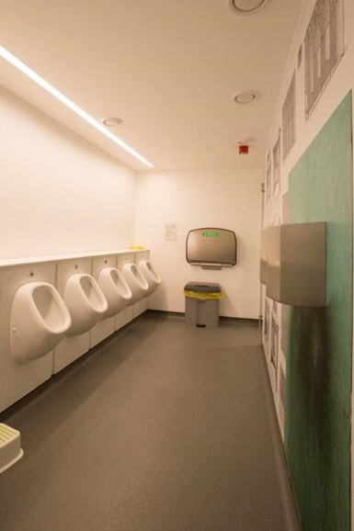
There are toilets near reception. The lights are bright. The lights are activated by a sensor and are on a timer so will turn off after a while. The flush on the toilets is activated by a sensor. There are hand dryers which can be loud.

Slide 7

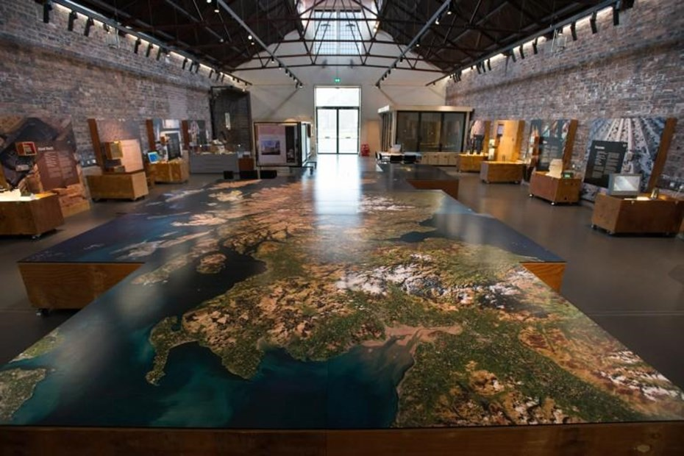
In this space there are lots to see and do. If there are lots of people in this space it can be loud.

Slide 8
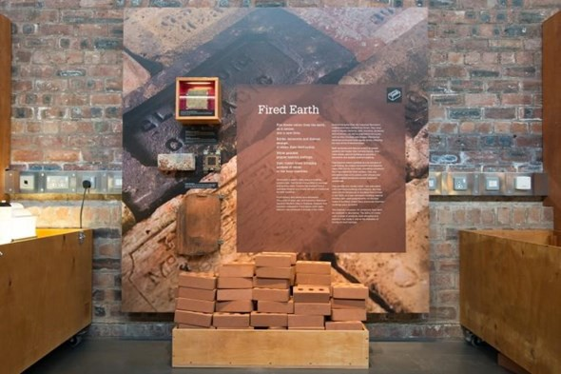
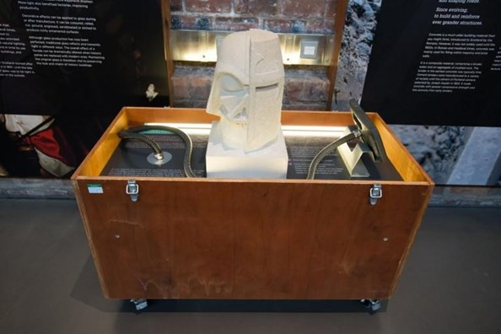
There are panels with stories to read and objects to touch.
There are boxes with activities in them for you to investigate.

Slide 9
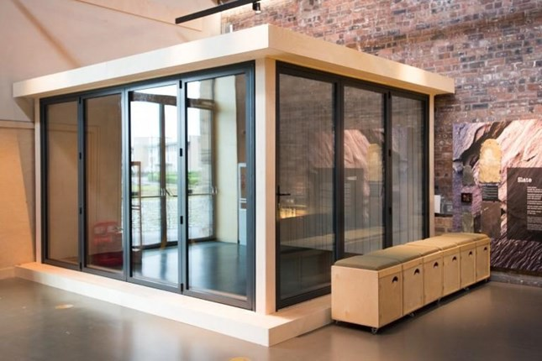
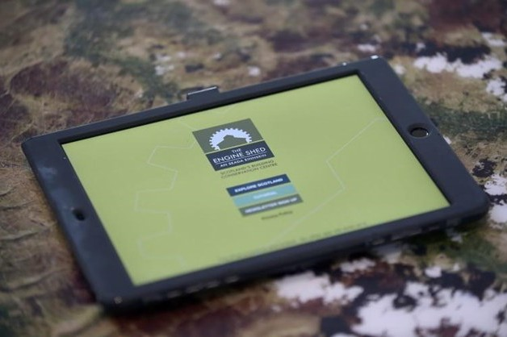
There is a pod where traditional crafts people sometimes work. If they are working it can be loud and dirty in this space.
There is a map of Scotland. If you have borrowed a tablet from reception you can use it here. If you are not sure how to use it you can watch the tutorial video or speak to a member of staff or a volunteer.

Slide 10
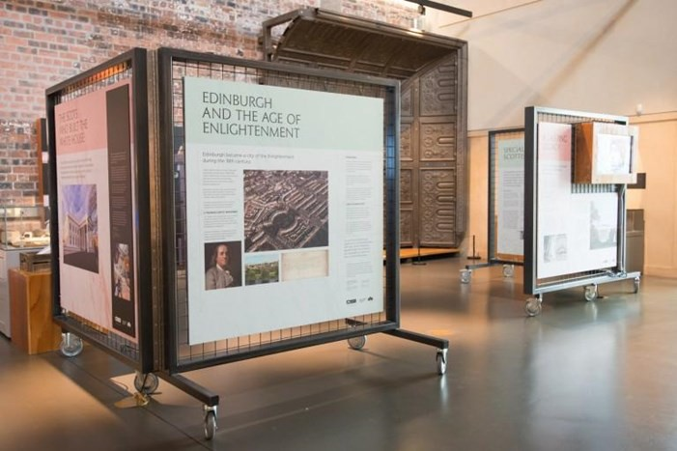
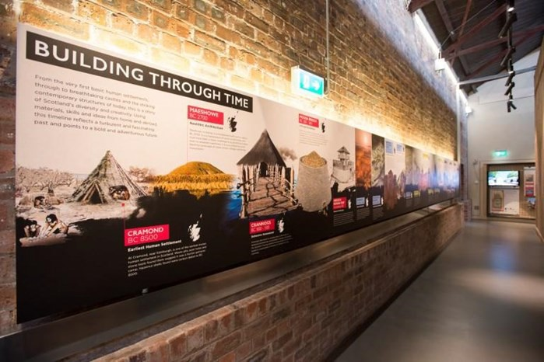
In this space there is a temporary exhibition. There are screens which can be loud. The temporary exhibition changes twice a year.
In this space there is a timeline. It can be dark. There are screens which can be loud.

Slide 11

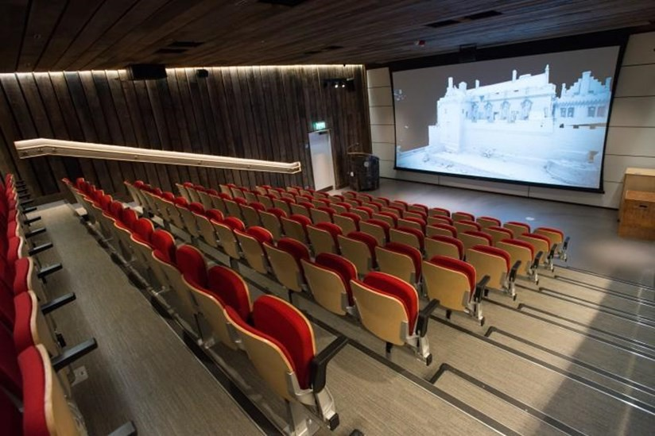
In this space you can watch films or hear talks. It can be dark, loud, and cold inside. You can enter and leave the auditorium whenever you like.

Slide 12

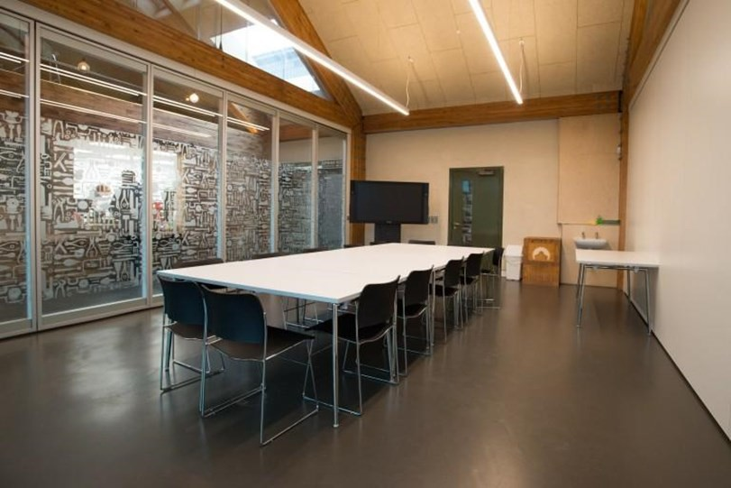
In these spaces meeting and activities take place. Sometimes Engine Shed staff will need to move tables and chairs around. This can be loud.

Slide 13

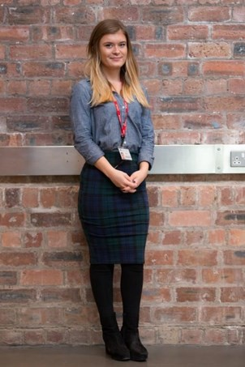
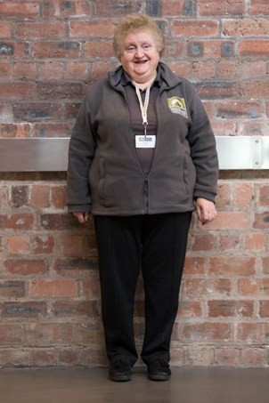
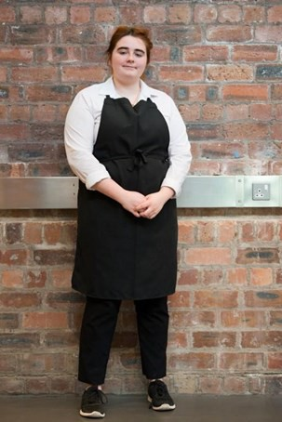
Engine Shed staff member.
Engine Shed volunteer.
Coffee Point staff member.
At the Engine Shed these people can help you.

Slide 14
Further information:
For further information about access at the Engine Shed please visit engineshed.scot/visit/access, call 01786 234 800 or email technicaleducation@hes.scot
Thank you:
We would like to thank the Scottish Women’s Autism Network for their support during the development
of this resource.
© Historic Environment Scotland - Scottish Charity No. SC045925

